Slide 2
Tokens
Authenticate identities
Electronically store personal info
With or without a password
Notes:
IETF RFC 4226

Slide 3
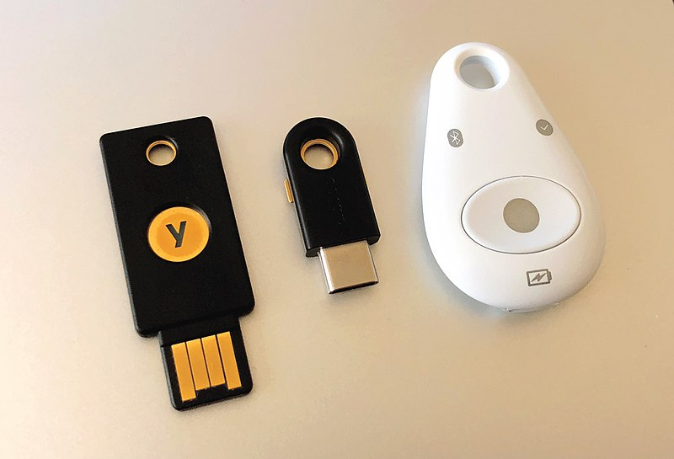
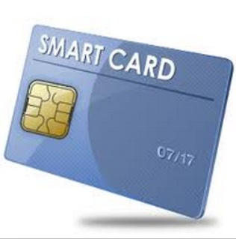
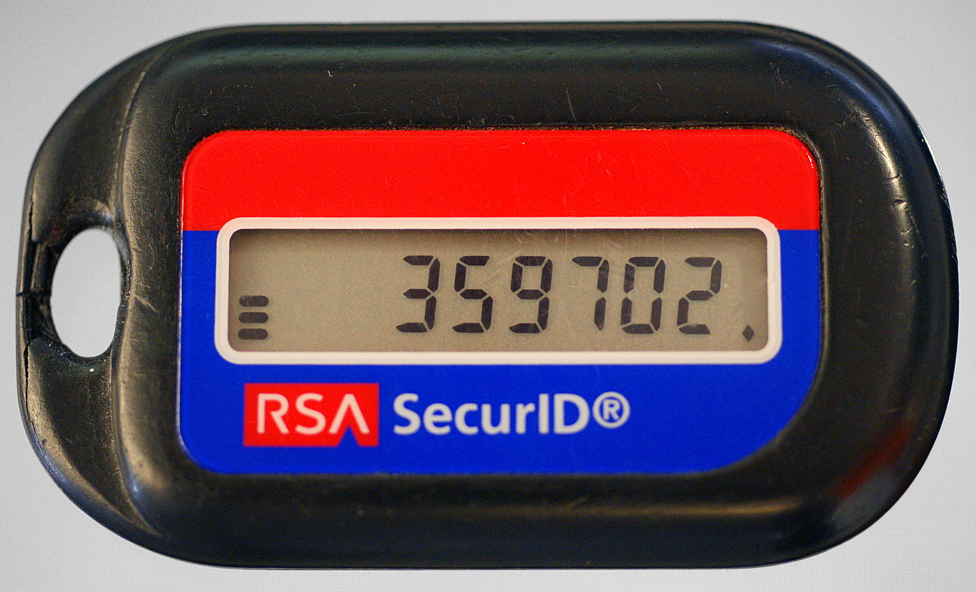
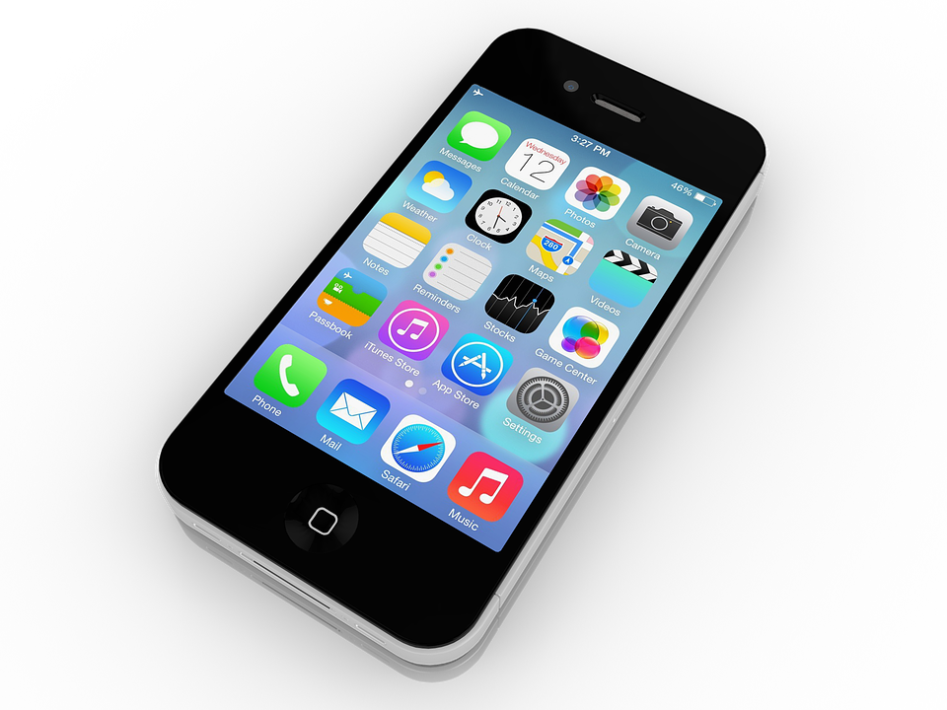
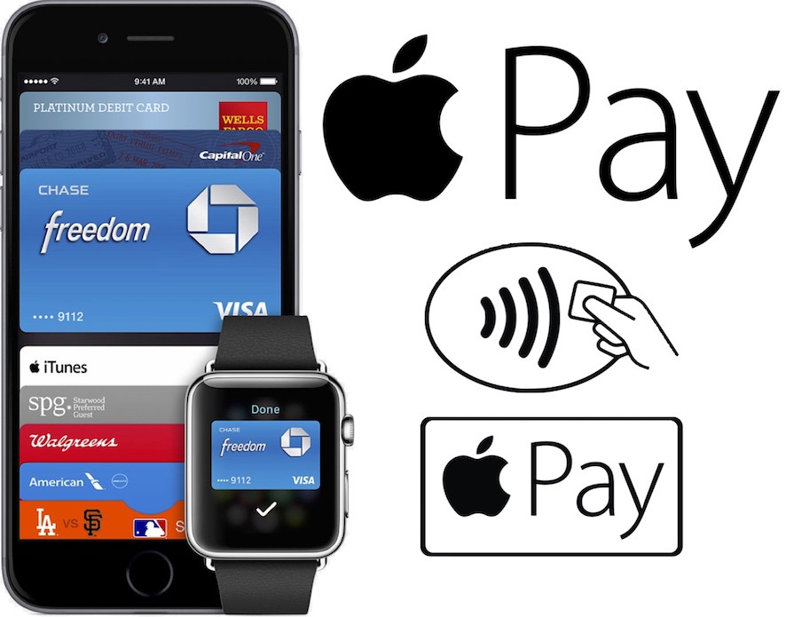
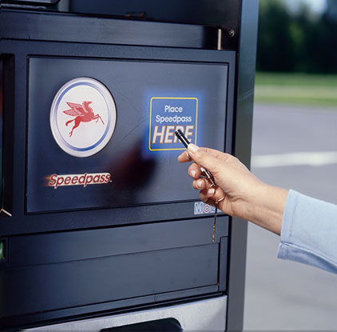
Token Types
Connected
Physical connection
YubiKey, FIDO, smartcard
Disconnected
No physical connection
Authenticator app, RSA SecureID
Contactless
No physical connection
Contactless payment
Notes:
Connected – Transmits authentication information to the client computer when physical connection is made
Objectives Mention - Smart Card authentication
Disconnected – Objective mention - Authenticator Apps, Push notification via SMS or a phone call
Contactless– Transmits authentication information to the device via a logical connection, not requiring a physical connection
RFID, Bluetooth, NFC
Think mobile speed pass
Remind about OATH and FIDO

Slide 4


One-time Passwords
User logon
OTP
Authentication Code
563302
Verify
Notes:
IETF RFC 4226

Slide 5
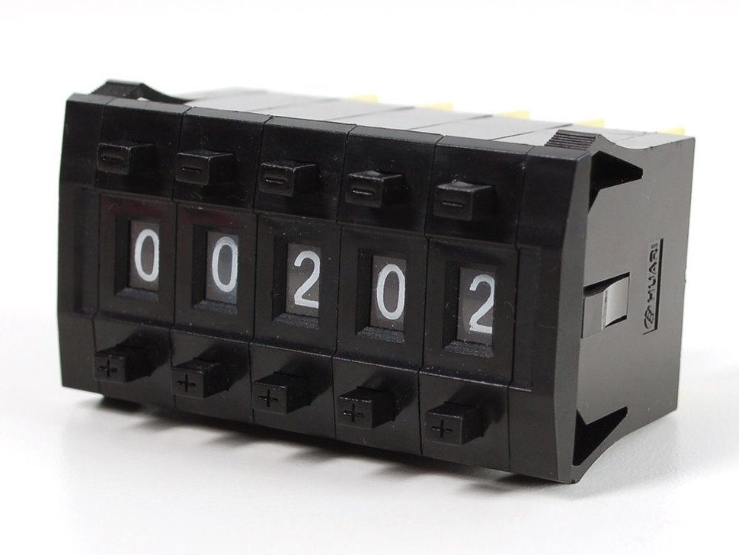


HMAC-based OTP
Uses HMACs
Expire upon use
Secret key
(Seed)
Counter
HOTP
Authentication Code
HMAC
563302
Verify
Notes:
RFC 4226
Static codes that are susceptible to replays

Slide 6

Time-based OTP
Like HOTP
Expire without use
Secret key
(Seed)
Timer
TOTP
Authentication Code
563302
HMAC
Verify
Notes:
RFC 4226
Show the DN of and Active Directory Object
dsquery user/computer –name <name>

